Slide 1


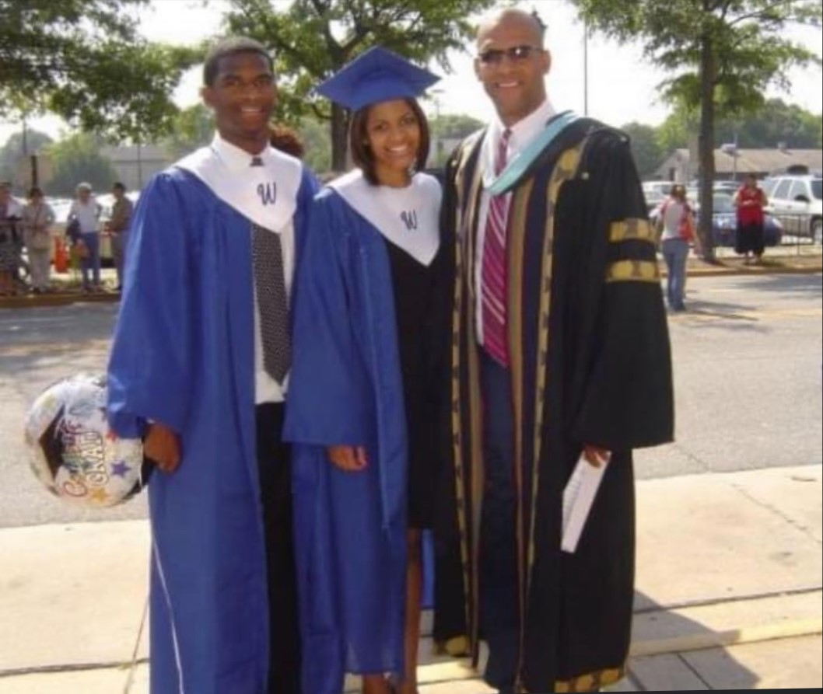

Westside High School
Morehouse College
Bachelor of Arts
Kinesiology
Auburn University
Masters of Education
Teacher Education/Physical Ed
Coach Ethan Taylor
GYM B Room 308
#Patriots W.A.R.
(Whole-Hearted; Accountable; Respectable)

